Slide 1

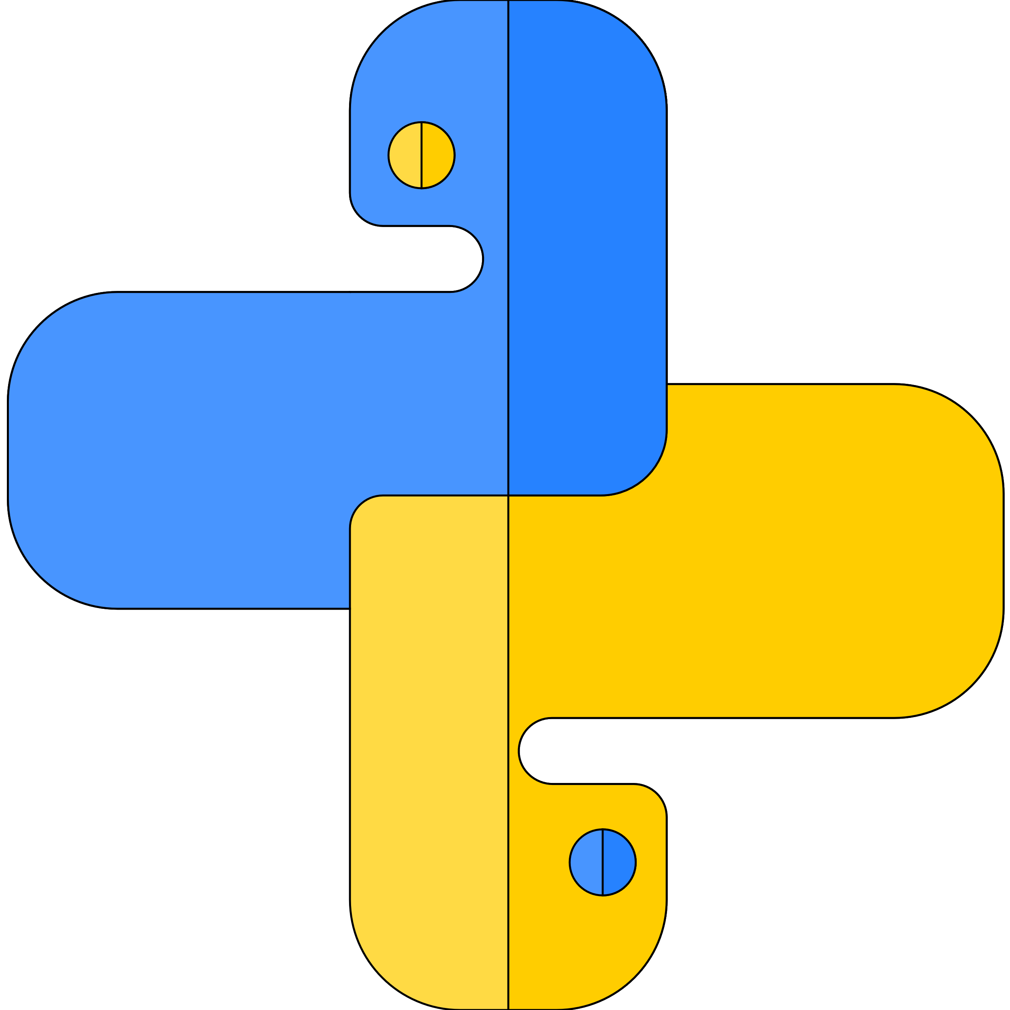


Python Objects
Author : Aman Singh
Lecture 6

Slide 2
Today’s Agenda
What is object?
Importance of Objects
Properties of Objects

Slide 3


What is an Object?
?
Let’s start…

Slide 4
Objects…
Python contains many data types as part of core language. Its import to understand that all data in python program is represented by objects and relationship b/w objects.
Everything in a real world scenario is an object.
Object is simply a collection of attributes and methods or variables and Functions in other words.

Slide 5
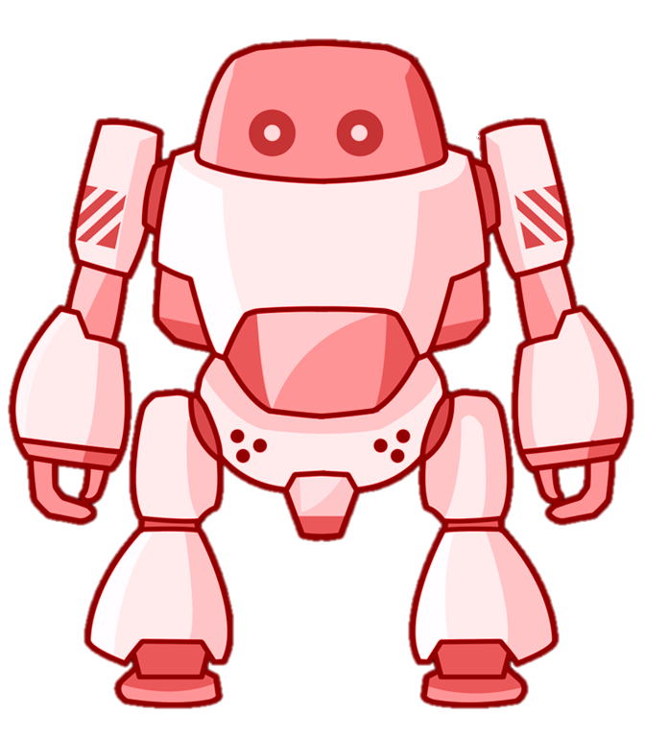
Hello There!
I am chitti the robot.
Name: Chitti
Colour: Purple
Job: Dance

Slide 6
Objects…
Values of Objects can be changed during the program execution.
The objects whose values can change are called Mutable objects whereas objects whose values are unchangeable are called Immutable objects.
In python every object has three characteristics:
Type: object type tells what kind of object we are dealing with. like (string, list, tuples, etc.)
Value: Data that is contained by the object.
Id: its is a number to identify different objects.
Two immutable objects can have same ids in python. Whereas for mutable objects id is always different.
Two distinct object has same methods but not same attributes.

Slide 7
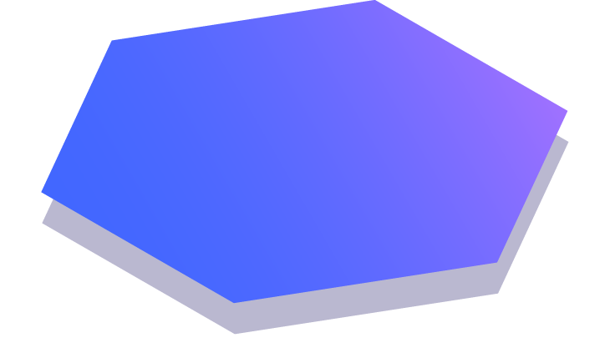
Thanks!
Any questions?
Just Comment down below.
If you like this video don’t forget to Subscribe and Share
You can find me at singhaman11415@gmail.com

